Slide 1
Structural borrowing from English into hong kong cantonese
香港粵語裡的結構外借現象
2nd Macau Roundtable on linguistics
第二屆鏡海語言學圓桌會議
University of macau, December 4, 2021

Slide 2

Brian Hok-Shing Chan
Department of English,
Faculty of Arts and Humanities
University of Macau
陳學成
澳門大學人文學院英文系

Slide 3
major Areas of research
Code-switching (syntax, pragmatics and sociolinguistics)
Code-switching in pop songs
Translanguaging
Hong Kong English
Sentence-final Particles in Cantonese
Linguistic Landscape in Macau
Multimodality

Slide 4
Publications
Google scholar: https://scholar.google.com/citations?user=gpeLSg8AAAAJ&hl=zh-CN&oi=ao
ResearchGate: https://www.researchgate.net/profile/Brian-Chan-14

Slide 5
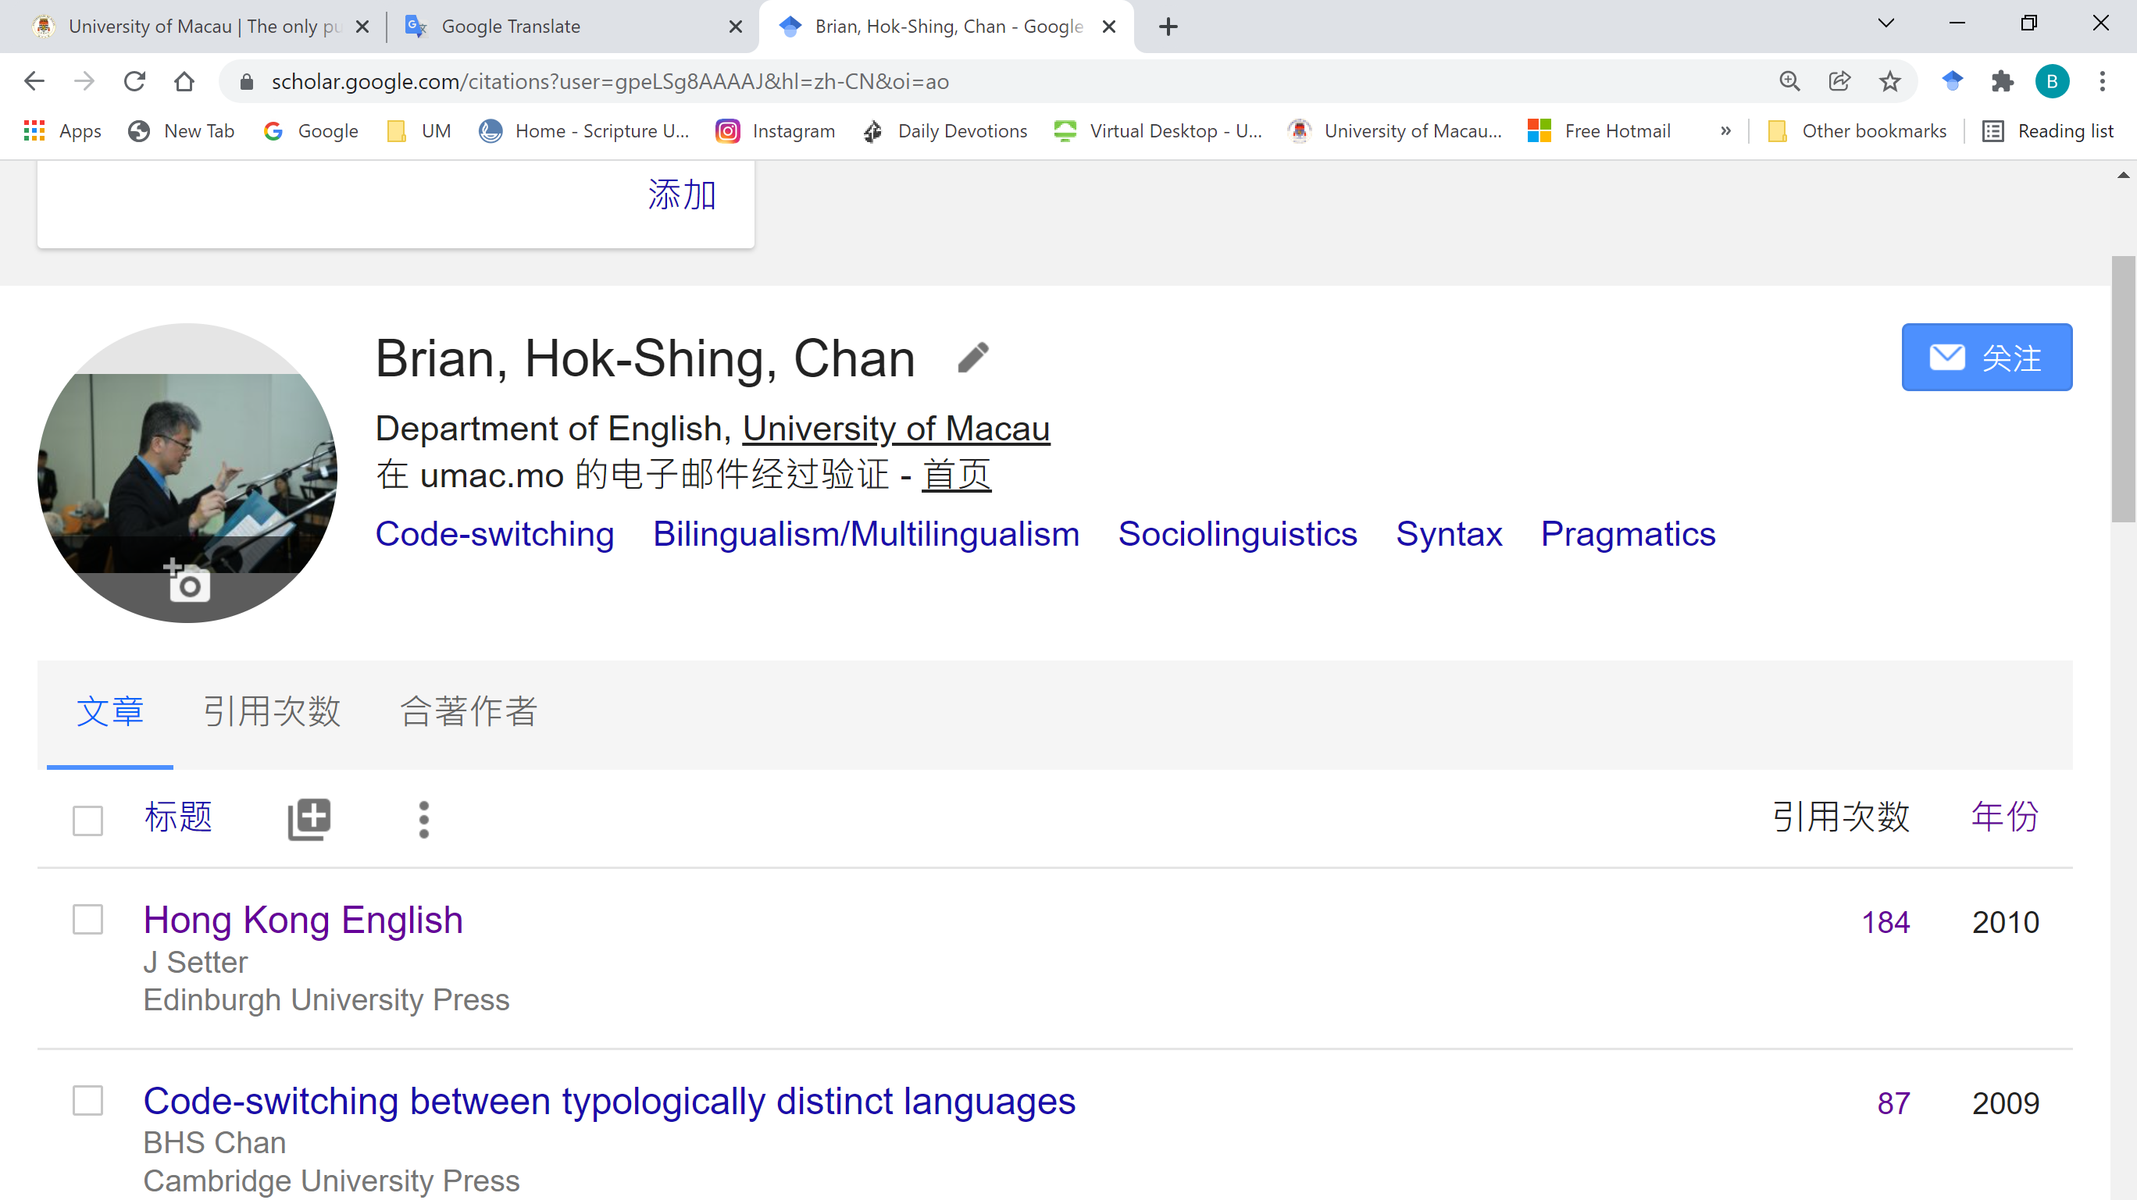

Slide 6


Slide 7
Code-switching (intra-sentential)
Cantonese-English
你呢個semester take 咗幾個course呀？
一陣落堂要見professor
你要keep住做運動
大家唔啱channel
你要passionate about your job

Slide 8
The matrix language frame model (Myers-scotton 1993, 2002, etc.)
The Matrix Language sets the grammatical structure of a code-switched sentence by determining its word order and supplying the function words and bound morphemes, technically known as the system morphemes in the MLF Model.
The Embedded Language only supplies content words or content morphemes to a code-switched sentence.
A large part of Cantonese-English CS data documented so far fit into the MLF model with Cantonese being the Matrix Language and English being the Embedded Language.

Slide 9
Remaining puzzles
Q: Is it possible for English morphology/grammar to infiltrate into Cantonese (hence violating the MLF model)?
A: Yes, but these patterns seem to be restricted.
Q: If these patterns are limited, why are they used in the first place?
A: They achieve some semantic/pragmatic effect that cannot be conveyed by corresponding constructions in HK Cantonese. Economy, however, is not so much a motivation.
Q: Why are these patterns limited?
A: Speakers tend to draw a boundary between two “languages” by keeping their syntax separate. (Implications)

Slide 10
Structural borrowing from English in hk cantonese
3 patterns
which-relative (Leung 2010)
Complex NP involving a PP postmodifier with an English preposition (Chan 2015)
NP hai6 P(English) NP (Chan 2018)

Slide 11
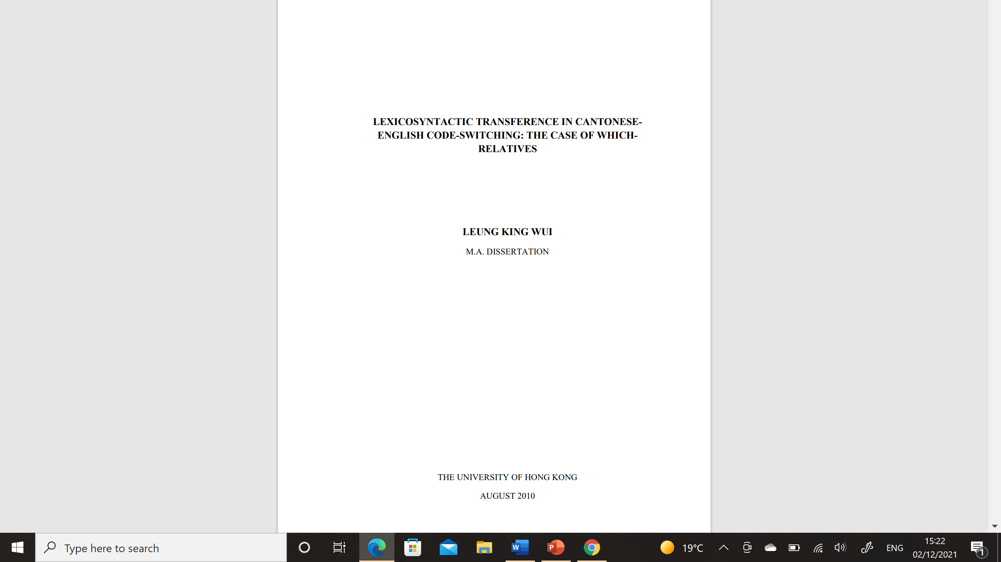

Slide 12
Which-relative in hk cantonese (leung 2010)
In Chinese varieties, including Cantonese, relative clauses are largely premodifying and prenominal whereas relative clauses in English are postmodifying.
ceoi4-fei1 [keoi5 dei6 hai6 wui2 fuk1 jan4 ge3 gei1-kau3]CLAUSE,
unless 3 PL COP will reply people NOM organization
which ngo5 m4 zi1 hai6-m4-hai6 gam2 aa3…
which 1 NEG know COP-NEG-COP so SFP
“Unless they are an organization who will make replies (to inquires), which I don’t know is true or not…”
(Leung 2010: 71)

Slide 13
Which-relative in hk Cantonese (leung 2010)
[zoeng1 zi2 soeng6-min6 ge3 man6-tai4]NP go3 camp jap6-min6 ji5-ging1
CL paper on NOM question CL camp in already
gong2 zo2 dit1-dit1,
discuss ASP a-bit
which ngo5 gok3 dak1 m4 sai2 zoi3 jiu3 recap
which 1 think PRT NEG MOD again have-to recap
“We already discussed the questions a bit on this sheet in the camp, which I think (we) don’t have to recapitulate.” (Leung 2010: 74)

Slide 14
Which-Relatives in hk Cantonese (Leung 2010)
keoi5 lei4 zo2 [di1 lou5-si1 zau6 hoi1-ci2 fan1-dong2-fan1-paai3]CLAUSE,
3 come ASP QUAN teacher LNK begin divide party divide party
which is zi1-cin4 mou5 ge3.
which is before NEG SFP
“After she came, the teachers had started to divide themselves up into different parties,
which did not happen in the past.” (Leung 2010: 73)

Slide 15
Which-relatives in hk cantonese (leung 2010)
tung4-maai4 zak1-bin1 dou1 jau6 hou5 do1 ni1 di1 dak6-sik1 ge3 shops,
and side also EXIST EMP many DEM CL character NOM shops
hou2 British ge3 shops,
EMP British NOM shops
which is hai6 nei5 hai2 Leicester m4 hai6 hou2 gin3 dou2
which is COP/FOC 2 LOC Leicester NEG COP DEG see ASP
“And at the side (of the road) there are many characterful shops, very “British” shops, which
you don’t come across very often in Leicester.”
(A Youtuber is paying a visit to Nottingham, anecdotal data, 2021)

Slide 16
Which-relative in hk cantonese
The relative clause is in fact non-restrictive and supplementary, mostly postmodifying a previous clause, and it always follows a clause (rather than being embedded in it).
The relative clause introduces a comment on the previous clause/NP which involves an assessment of the speaker.
Which-relative as a contextualization cue (Gumperz 1982)

Slide 17
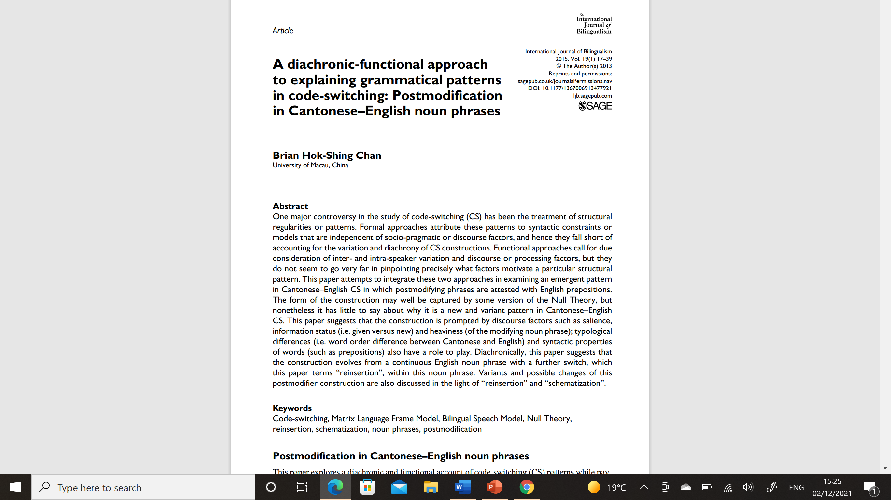

Slide 18
Complex NP with a postmodifying PP (Chan 2015)
keoi5 dei6 hai6 [plenary speakers [of go2 go3 conference]PP]NP
3 PL COP plenary speakers of DEM CL conference
“They were the plenary speakers of that conference.”
(Chan 2015: 18)
keoi5 dei6 hai6 [go2 go3 conference ge3 plenary speakers]NP
3 PL COP DEM CL conference NOM plenary speakers
“They were the plenary speakers of that conference.”
(Paraphrase)

Slide 19
Complex np with a postmodifing pp (chan 2015)
keoi5 dei6 jing1-goi1 make [jat1-di1 contribution to go2 go3 academic community]NP
3 PL should make some contribution to DEM CL academic community
“They should make some contribution to the academic community.”
(Chan 2015: 25)

Slide 20
Complex np with a postmodifying PP (chan 2015)
ngo5 gong2 [go2 go3 cutting of go2 gin6 jacket]NP
1 talk DEM CL cutting of DEM CL jacket
“I’m talking about the cutting of the jacket.”
(Chan 2015: 29)

Slide 21
Complex np with a postmodifying pp (chan 2015)
The head noun is highlighted, or, in cognitive-linguistic terms, conceptualized as figure.
The noun/NP in the PP postmodifier is backgrounded or, in cognitive-linguistics terms, conceptualized as ground.

Slide 22
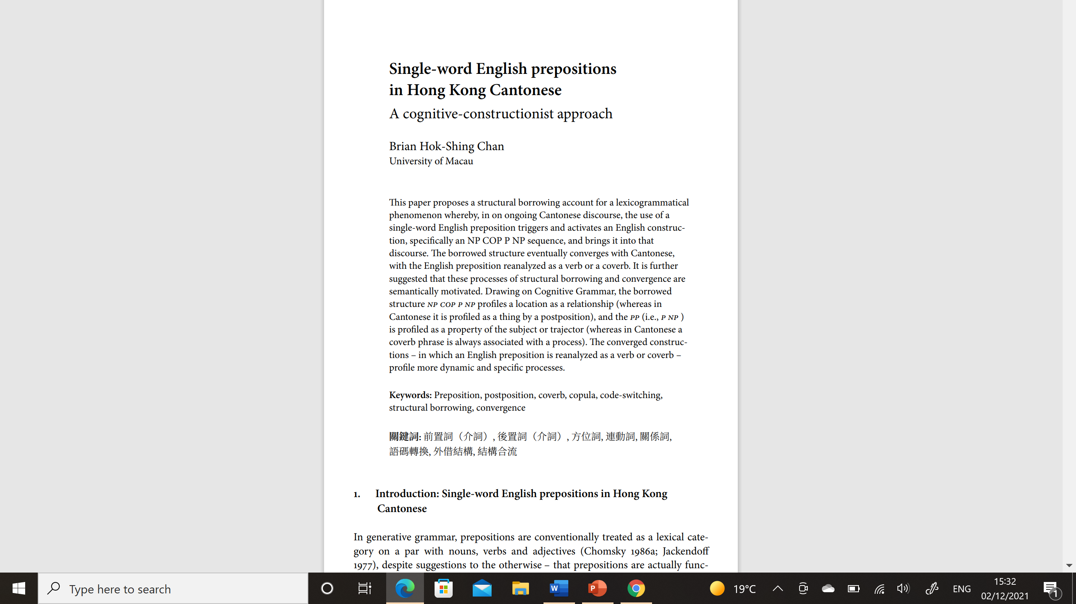

Slide 23
Np hai6 p(English) np (Chan 2018)
jat1 go3 society hai6 within jat1 go3 country wo3
NUM CL society COP P NUM CL country SFP
“A society is within a country, isn’t it?” (Gibbons, 1987: 61)
jat1 go3 society (hai6) hai2 jat1 go3 country (ge3) leoi5-min6 wo3
NUM CL society COP/FOC LOC NUM CL country NOM within/P SFP
“A society is within a country, isn’t it?”

Slide 24
Np hai6 P(English) np (chan 2018)
ni1 go3 course hai6 for di1 lecturers gaa3
DEM CL course COP for QUAN lecturers SFP
“This course is actually for the lecturers.” (Leung 2001: 132)
ni1 go3 course (hai6) wai5 di1 lecturers *(ji4 cit3) gaa3
DEM CL course COP/FOC COV CL lecturers LNK install SFP
“This course is actually for the lecturers.”

Slide 25
Np hai6 p(English) NP
jau5 jat1-bou6-fan6 jan4 dou1 hai6 from jau5-cin2 ge3 family
EXIST part person QUAN COP from rich NOM family
“Some of these people are also from rich families.” (Chan, 2018: 51)
jau5 jat1-bou6-fan6 jan4 dou1 (hai6) lei4-zi6 jau5-cin2 ge3 family
EXIST part person QUAN COP come-from rich NOM family
“Some of these people also come from rich families.”

Slide 26
NP hai6 P(English) np (chan 2018)
The [NP hai6 P NP] construction conveys a different construal than the ones conveyed by its apparent counterparts in Cantonese.
Within/leoi2 min6 – the position is conceptualized as a RELATIONSHIP by within but a THING by leoi2 min6
For/wai2 NP ji4 cit3 – PP [for NP] conceptualizes a property of subject NP(trajectory), coverb phrase [wai NP] is an adjunct modifying the second predicate (i.e. ji4-cit3)
From/lei4-zi6 – From may be more schematic while lei4-zi6 – which spells out an action - is more specific.

