Slide 1




Interpreting Main Effect with Moderation
-- A View Through the Prism of Causal Dissection
Presentation at Antai College of Economics & Management
Shanghai Jiao Tong University
20 November 2017
Xinshu Zhao
zhao@hkbu.edu.hk
Chair Professor of Communication, Hong Kong Baptist University and Professor Emeritus of Media and Journalism, University of North Carolina at Chapel Hill，Cheung Kong Scholar Professor, Fudan University
香港浸會大學講座教授，美國北卡大學榮休教授, 趙心樹
2017年11月20日在
上海交通大学安泰经济与管理学院的演讲
1

Slide 2
Interpreting Main Effect with Moderation
-- A View Through the Prism of Causal Dissection
In many disciplines of social sciences, it’s widely believed that main effect is uninterpretable when moderation exists. This research starts with an observation that four popular mode of data analysis, mediation, moderation, curvilinearity, and confounding, all attempt to dissect an X→Y simple linear effect into various components.
Through this prism of theory, this research uncovers an important interpretation for the main effect, with or without moderation. The main effect, according to the theory of causal dissection, is a combination of two effects, namely on-group effect and in-group effect, while the in-group effect is a weighted average of the X→Y effects within each group defined by the moderator.
The research also proposes a typology of moderation, and proposes a genre of analyses, plenty and parity analysis, which is based on univariate analysis, moderation analysis, and causal dissection analysis.
Key words: regression, mediation, moderation, curvilinearity, confounding, causal dissection, plenty and parity analysis, main effect, on-group effect, in-group effect, typology of moderation.

Slide 3
Y = g₁ + cX | Eq. | 1
Y = g₂ + s_{p}C_{f} + c_{t}X | Eq. | 2
Y = g₂ + s_{p}C_{f} + c_{t}X | Eq. | 2

Slide 4
confounding, mediation and moderation
simple linear effect
  Y = g₁ + cX (Eq. 1)
confounding analysis
  Y = g₂ + s_{p}C_{f} + c_{t}X (Eq. 2)
mediation analysis (assuming s_{p}=0)
  Y = g₅ + dX + bM_{e} (Eq. 5)
  M_{e} = g₄ + aX (Eq. 4)
  Y = g₃ + c_{t}X (Eq. 3)
moderation analysis (assuming s_{p}=0)
  Y = g₆ + b_{a}X + b_{m}M_{o} + i(X*M_{o}) (Eq. 6)
  Y = g₇ + m_{x}X + m_{o}M_{o} (Eq. 7)
  M_{o} = g₈+ a_{x}X (Eq. 8)
  X = g₉+ a_{o}M_{o} (Eq. 9)
  Y = g₃ + c_{t}X (Eq. 3)

Slide 5


Sequence of Causal Partition
5
Figure 1
Sequence of
Causal Partition
Moderation Analysis
Effect partitioned: main effect (m_{x}), which is also direct effect (d) and/or 2nd-leg mediated effect (b).
Resulted components: different effects for different groups.
Curvilinear Analysis
Effect partitioned: substantial effect (c_{t}) or total effect (c).
Resulted components: different effects at different segments of independent range.
Mediation Analysis
Effect partitioned: substantial effect (c_{t}) or total effect (c).
Resulted components: direct effect (d) & two legs of mediated effect (a & b).
Confounding Analysis
Effect partitioned: total effect (c).
Resulted components: substantial effect (c_{t}) & superficial effect.
All Start Here:
X→Y Effect
Total effect (c) of X on Y
from simple regression.

Slide 6
Mediation and Moderation
Mediator
Me
Moderator
Mo
a
b
i
IDV X
DPV Y
IDV X
DPV Y
d
m_{x}
6

Slide 7
Main effect in Moderation
M_{o}-Mediated Moderation
M_{o}-Initiated Moderation
c_{t}
c_{t}
Mo
X
Y
Mo
X
Y
a_{x} (a)
m_{o} (b)
m_{x} (b)
i
a_{o} (a)
i
X
Y
Y
m_{x} (d)
X
m_{o} (d)
Mutual-Dependence Moderation
Mutual-Independence Moderation
Mo
c_{t}
c_{t}
X
Y
Mo
X
Y
a_{x} or a_{o}
(1a & 2a)
m_{o}
(1b or 2d)
i
a_{x}≈a_{o}≈0
(a≈0)
m_{o} (b or d)
i
X
Y
X
Y
m_{x}
(1b or 2d)
m_{x} (d or b)
7

Slide 8

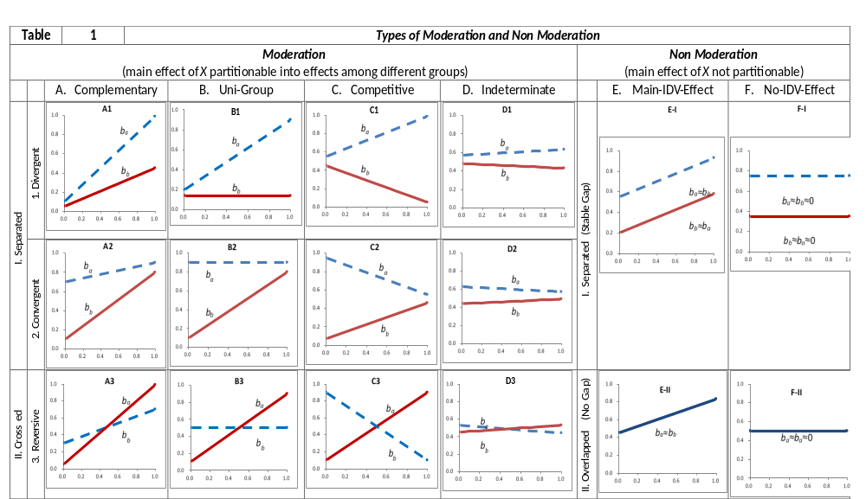
main effect to separate moderation and non-moderation
8

Slide 9
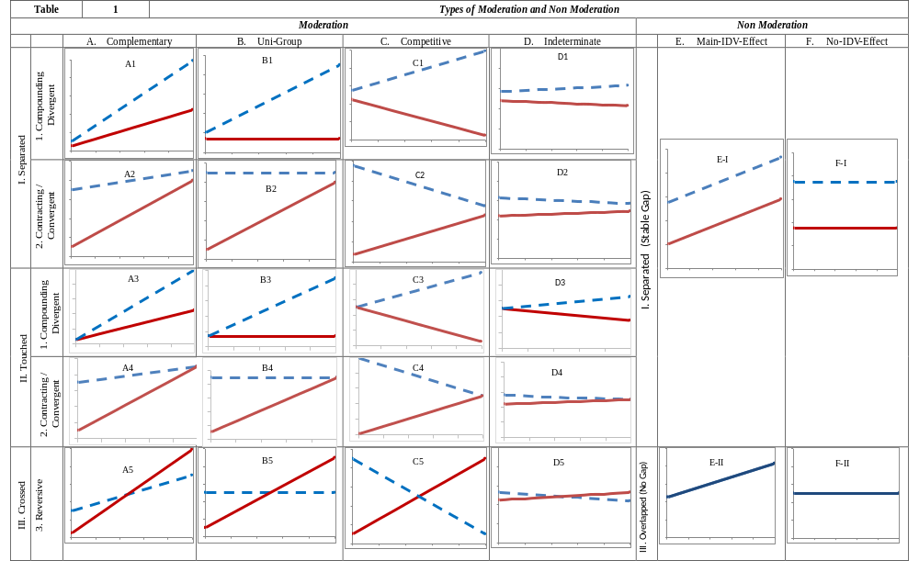
A typology of moderation and non-moderation

Slide 10
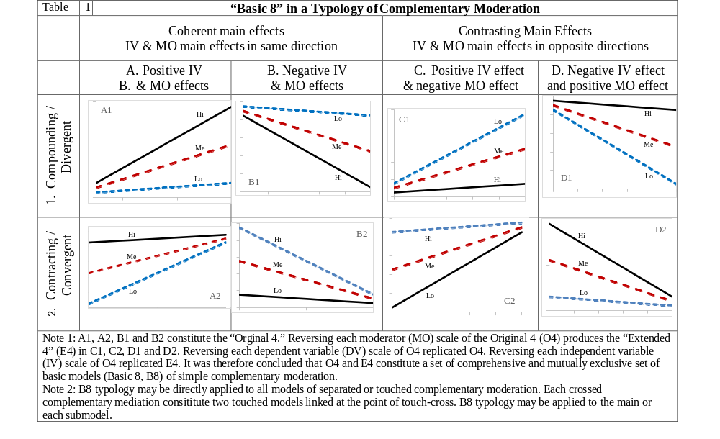
Basic 8 Types of Complementary Moderation

Slide 11

Traditional Media Reduce Digital Gap
highest income
main effect
lowest income
11

Slide 12
Acknowledgement
This research was supported in part by a donation from Dr. Lee Shau Kee, GBM, through HKBU Research Grant Scheme (LSK/14-15/P13, Zhao PI) and a China Ministry of Education Major Grant for Social Sciences through Fudan University Center for Information and Communication Studies (11JJD860007, Zhao PI).
鳴謝
本研究獲香港浸會大學「李兆基博士資助研究計劃」(LSK/14-15/P13，趙心樹主持) 及復旦大學信息與傳播研究中心「教育部人文社會科學重點研究基地重大項目」（編號 11JJD860007,趙心樹主持）资助。
12

Slide 13



Thank You
13

