Slide 1
Vampire Hypothesis
Nikolaus Boye and the first Swedish debunking

Slide 2
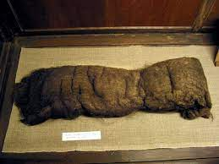
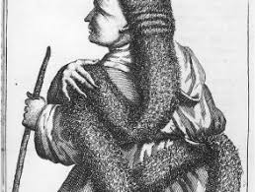
Plica Polonica

Slide 3
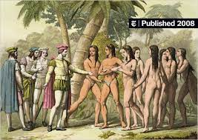
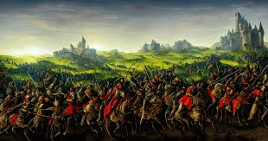
Origins of Syphilis

Slide 4
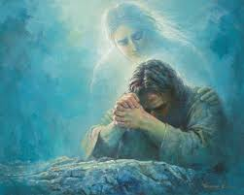
A Ministering Angel …

Slide 5
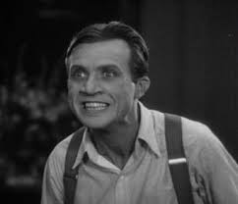
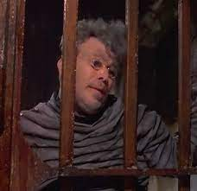
… and the Equivalent for Vampires

Slide 6
Boye’s Main argument
1) vampirism must be an endemic disease, but it is not.
2) four reasons why the vampire is not real, centring on
a) the falsity of superstition
b) speed of decomposition
c) blood in the chest
d) new fingernails, and new skin
3) spiritual argument – does not accept Paraceslan tripartite division of humans, and believes in day of judgement resurrection of the body

Slide 7
Main theories
Throughout Boye’s argument there is a need to explain through 2 major lenses
1) the medical theories of Herman Boerhaave, whom he never names, but whose work completely suffuses his debunking. Boerhaave very popular in Sweden at the time, partly thanks to Kilean Stobaeus.
2) Lutheran theology – one can only be ressurected once, which is in God’s hands.
Is bound by Fluckinger’s report, which he correctly dissects into major themes, despite the fact that the Visum et Repertum is really a body by body description of 14 corpses.

Slide 8
Endemic diseases
If vampirism is a medical disease it must be one endemic to an area
He names four– Plica Polonica, Scrofula, Phthisis and venereal disease.
Plica Polonica, which involved matting of the hair, ulcers, weakness , fever and eventual death, was mainly found in Poland or East Germany – cutting off hair was fatal. Many now believe that this disease was not real.
Scrofula he sees as endemic to Bergamo and Northern Italy. But it is in fact the same disease as Phthisis: both Tuberculosis. Maybe because it was heavily investigated and documented in Livorno, where they had quarantine facilities. Boerhaave, in his “Institutes”, also observes the phenomenon of women having neck tumours
Syphilis he sees as endemic to Naples, despite having been brought there, as he freely admits, by Spanish mercenaries (thanks to Columbus) fighting for the king of France. This may be his Lutheran contempt for vices of the south, but he misreads his source,de Jussieres, who blames the mercenaries themselves.

Slide 9
Superstitions
Complaints by victims that they had been attacked by vampires, Boye refutes by reference to fact that other superstitions have been debunked.
The changeling child is simply hydrocephalus, the sudden chill on the body as one passes a gallows is simply fear (the only emotion, according to Aristotle, that can cause imbalance of humours), while the nixe attacking swimming persons (in Sweden and Germany) is simply contraction of the muscles. Boerhaave also describes how the muscles contract in relation to cold.
In all these cases he is using local examples to explain something he did not witness himself.

Slide 10
Slow decomposition of the body
Here he resembles Buddeus, Frisch and Jablonski, whose “Opinion”(1732) also debunked vampirism using similar means.
He notes that decomposition of the body can be related to prevalence of alum or salt in the ground, or due to weather, using again local examples, like the man exhumed after 23 days which he himself presided over.
Like Buddeus, Frisch and Jablonski he also believes that fat bodies may decompose more slowly than slim ones.
Unfortunately he had not read the report by Glaser, the original autopsist at Medvedia (not Fluckinger), who discovered that it was the thin bodies that decomposed least quickly.

Slide 11
Blood in the chest
Like Frisch, Buddeus and Jablonski, the Prussian scientists, he questions why blood is in the chest and not in the stomach if it has been ingested.
He assumes, since the victims were mainly young adults, that prevalence of blood to do with a februm ardentum, to which the young are most susceptible.
This shows influence of Boerhaave again, since the Dutchman devotes some space to the februm ardentum, a result of too much frenetic activity in which the capillaries and tubes of the bodies do not have as yet strong enough walls, making the bursting of blood inevitable.

Slide 12
Fingernails and new skin
His glib explanation for the regrowth is the same as the three Prussians, who observe that nails can regrow in bodies.
Does not go so far as Nils Retzius five years later, who sees tuberculosis as being the cause

Slide 13
Spiritual reasons
Boye keeps to the Lutheran belief that the body will be reunited to the soul at day of Judgement, and thus it cannot be united before.
If corpses are literally leaving their graves, this means they must have a ministering spirit helping them.
His beliefs lead him towards dualism and thus to implicitly eschew the belief that the human being is divided into three parts: immortal soul, functioning spirit, corporeal body – the view of Paracelsus.
This belief takes him into another implicit conflict with not only Cambridge Platonists like Henry More, but also with Boerhaave, who assumes that muscles are governed by animal spirts, mediating between soul and body.

Slide 14
Impact
Noebling. The same year, 1732, Johann Noebling produced his own refutation of the Visum et Repertum which made the incubus, or sleep paralysis dream, the major cause for the vampire superstition. Boye may have suggested this idea, although quickly dismissed it. (Noebling must have read Frombald’s report from Kisilova, and not just Fluckinger’s)
In 1737 Nils Retzius, at University of Lund, cites Boye as a source. He also makes the incubus the major cause of the effects of vampirism, although his arguments do not really reflect Boye’s ideas at all.
Johann Leche, in 1739, writes a thesis on the powers of the Egyptian mummy, specifically the one at the University of Lund in the museuem Stobiana, in which he cites Boye as being a major source for his understanding of corpse preservation.

