Slide 1
Bram Stoker, the Lyceum Theatre and the seeds of a new novel

Slide 2
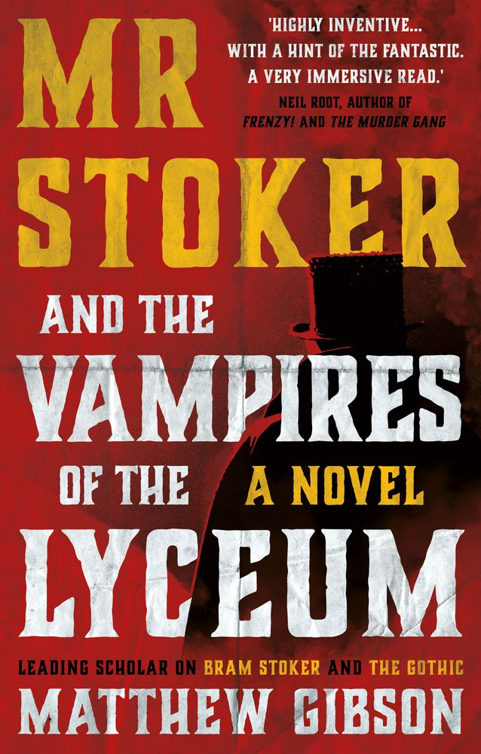

Slide 3
My Path to Dracula
After a PHD, and my first academic book on W.B. Yeats and S.T. Coleridge, I turned my attention to another Irish writer, Bram Stoker.
After working in Poland, I worked in Bulgaria, teaching Bram Stoker’s masterpiece, Dracula, to Balkan students.
Decided to rectify the idea that Dracula was a reaction to Ireland, and became more interested in seeing the work as a reaction to the Eastern Question.
Also became interested in earlier ‘Balkan’ vampire tale – J.S. Le Fanu’s Carmilla (1872)

Slide 4
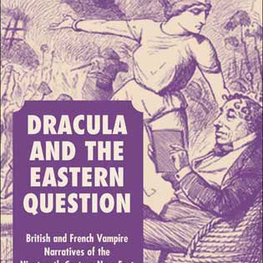
Second monograph
Dracula and the Eastern Question (Palgrave Macmillan, 2006). This book explores the work of Stoker, Le Fanu, Jules Verne and others as commentary upon the Eastern Question.

Slide 5
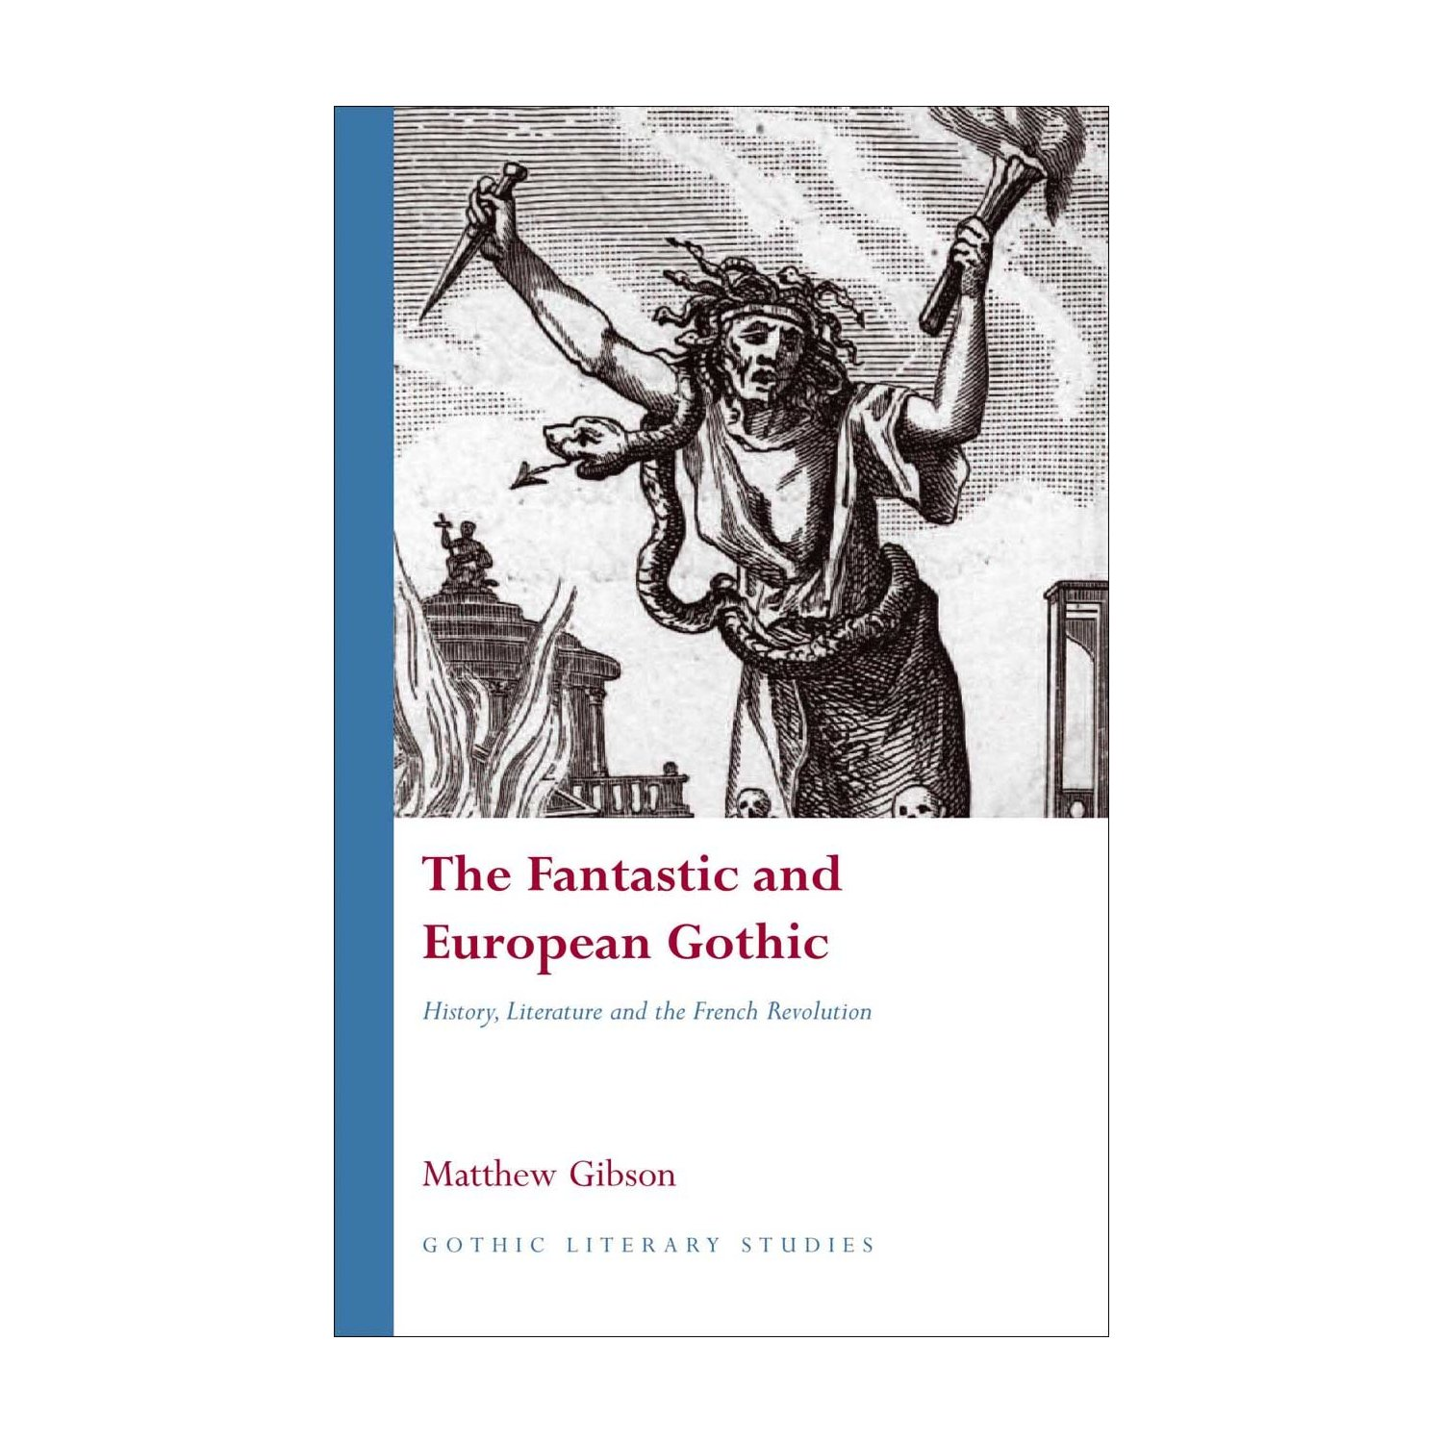
Third monograph
A book which examines the rise of the Fantastic in France and Germany, its political significance, and effect on later British Writers

Slide 6
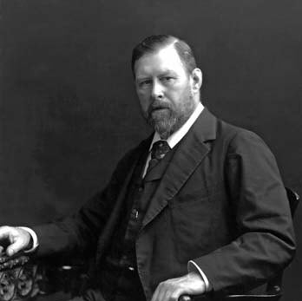
Bram Stoker

Slide 7
Collecting Letters
While writing Dracula and the Eastern Question I had to read letters, starting with those of Anthony Hope and Sergei Stepniak.
Got me to realise that the dismissal of the Brotherton Collection archive was not correct, and found many new and interesting points.
EgArchibald Ross Colqhoun, who sends Stoker list of books on the Balkans - second Balkan novel, The Lady of the Shroud (1909), none of which he appears to have consulted (although did give him some useful names)
Rather more likely Edith Durham and William Denton.

Slide 8
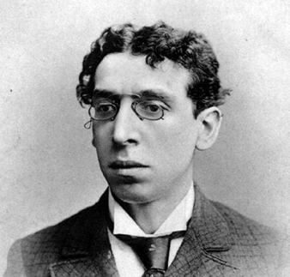
Israel Zangwill 1864-1926
Author of plays such as ‘Melting Pot’ (1909), and novels such as Children of the Ghetto (1892).

Slide 9
Letter from Zangwill
24, Oxford Road,
Kilburn, N.W.
July 7/93
Dear Bram Stoker,
Will you please let me have seats or the next (& last) performance of “Merchant of Venice” on the 17th. I have never seen Irving’s Shylock.
With regards
Yours Sincerely,
I Zangwill
P.S. you seem to have been away early from the Lord Mayor’s, before I had time to speak to you. Were the speeches too much?

Slide 10
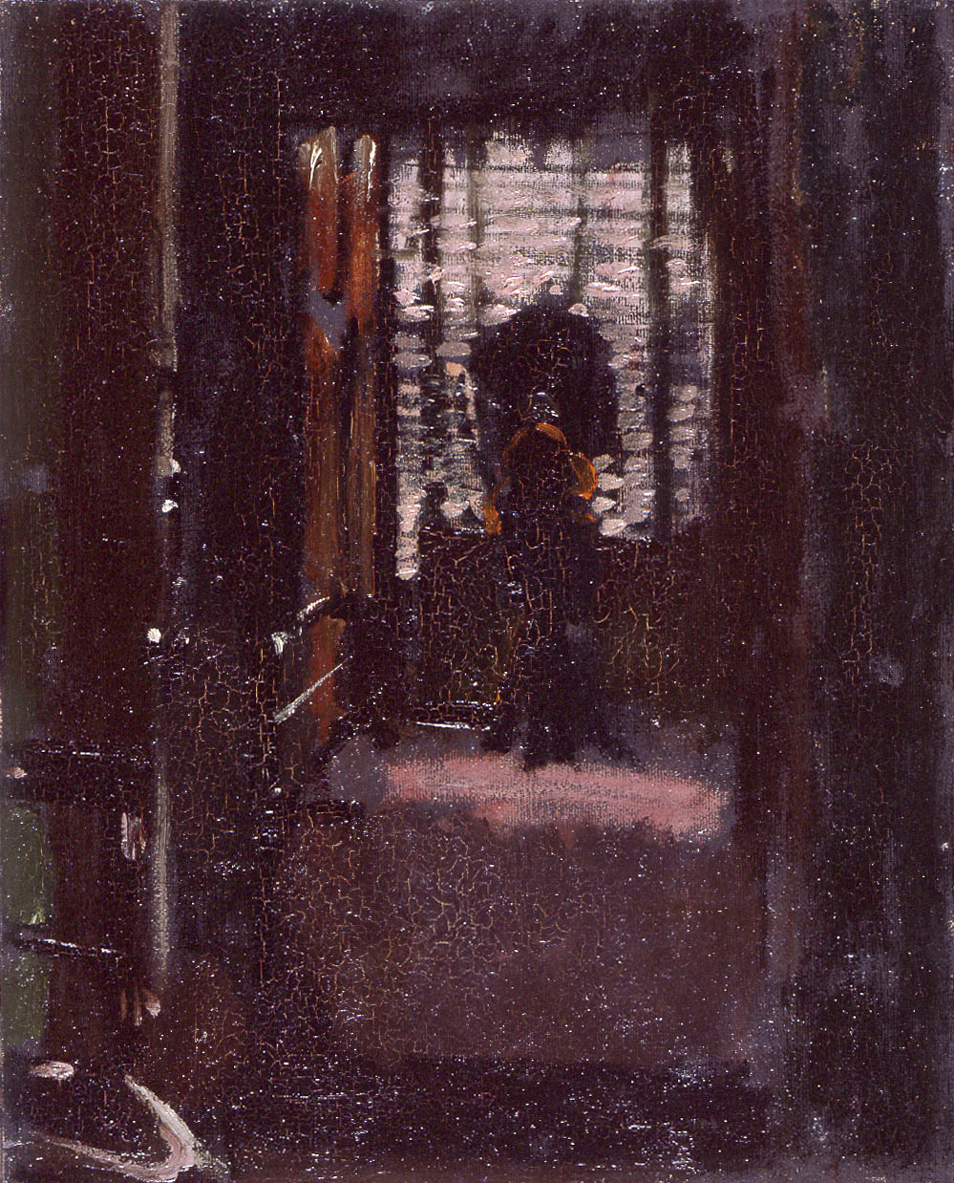
Walter Sickert
1860-1942
Jack the Ripper’s Bedroom (1907)
Sickert was originally an actor in Henry Irving’s company, as was later Edward Gordon Craig.

Slide 11
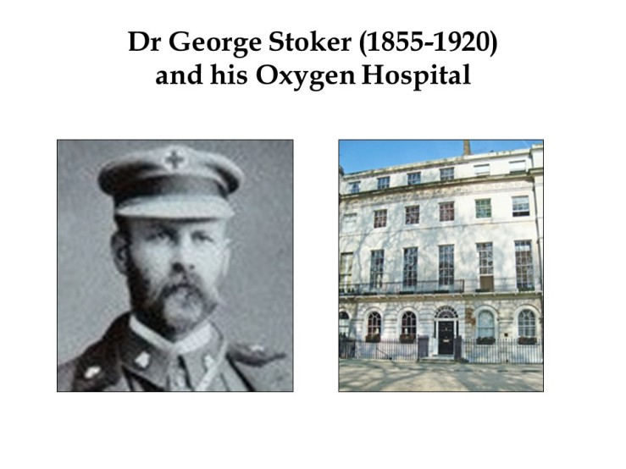

Slide 12
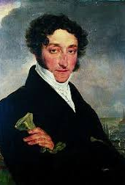
Charles Nodier 1780-1844
Adapted John Polidori’s The Vampyre to the French Stage in 1820, having published a sequel, ‘Lord Ruthven’.
Wrote vampire tale in the form of Smarra (1821), and also wrote fantastic tales involving real people.

Slide 13
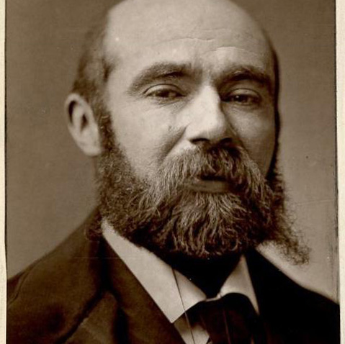
Paul Féval, père (1816-1887)
French novelist
Author of La Vampire (1856; 1865).
Le Chevalier Ténèbre (1860).
La Ville Vampire (1874).
Vampire stories which combine fantastique with real history.
Some would say, the first ‘mash-up’!

Slide 14
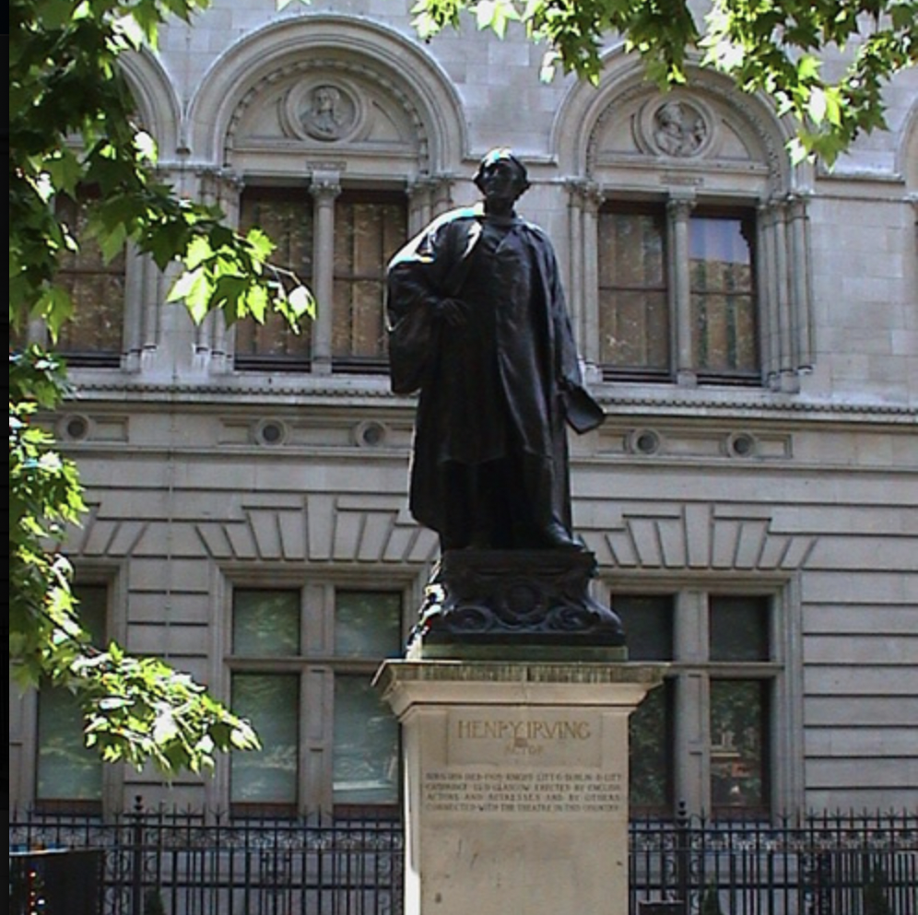
Henry Irving
The famous statue at the bottom of Charing Cross Road.

Slide 15
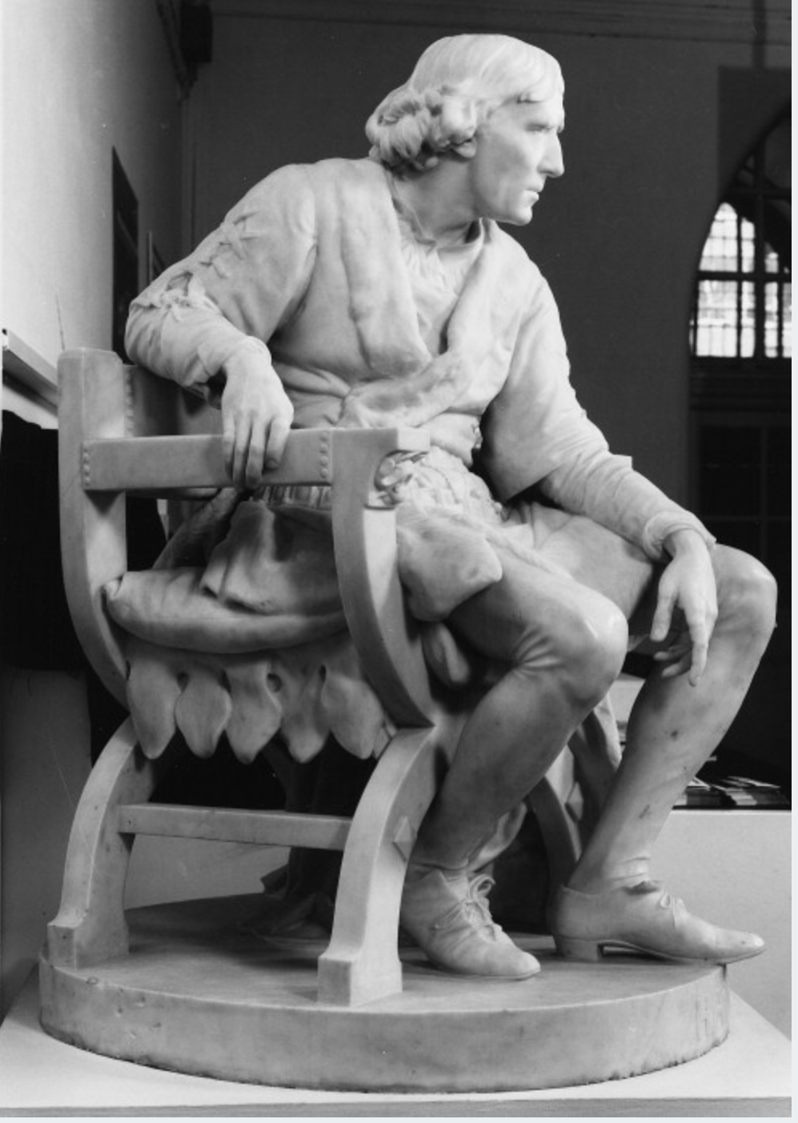
Henry Irving as Hamlet
By Edward Onslow -Ford

Slide 16
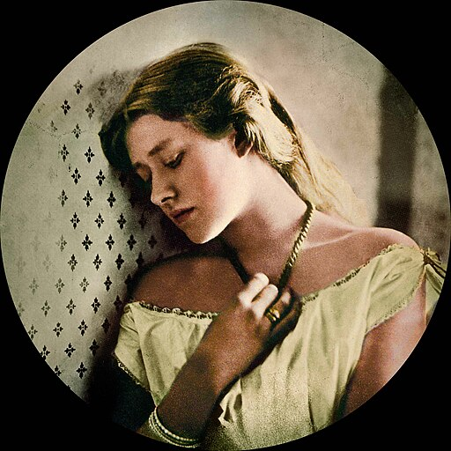
Ellen Terry atb age 16

Slide 17
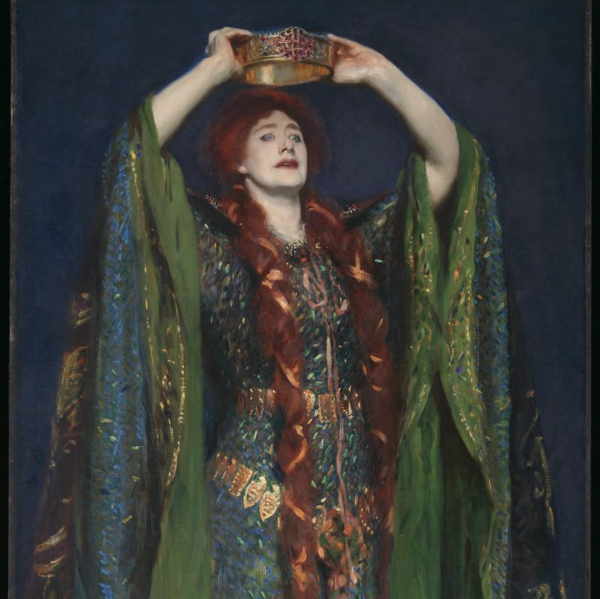
Ellen Terry as Lady Macbeth
By John Singer Sargent

Slide 18
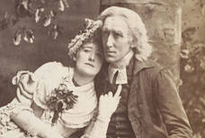
Ellen Terry and Henry Irving in costume for “The Bells”

Slide 19
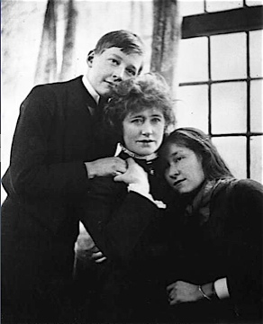
Ellen Terry with her children, Edward Gordon and Edith

Slide 20
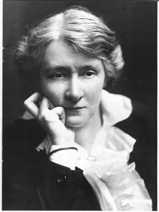
Edith Craig, in middle age
Actress, costumier and writer, ultimately devoted to her mother’s legacy, and preserved her legacy but quarreled with her brother. Ardent member of the women’s movement and suffragette

Slide 21
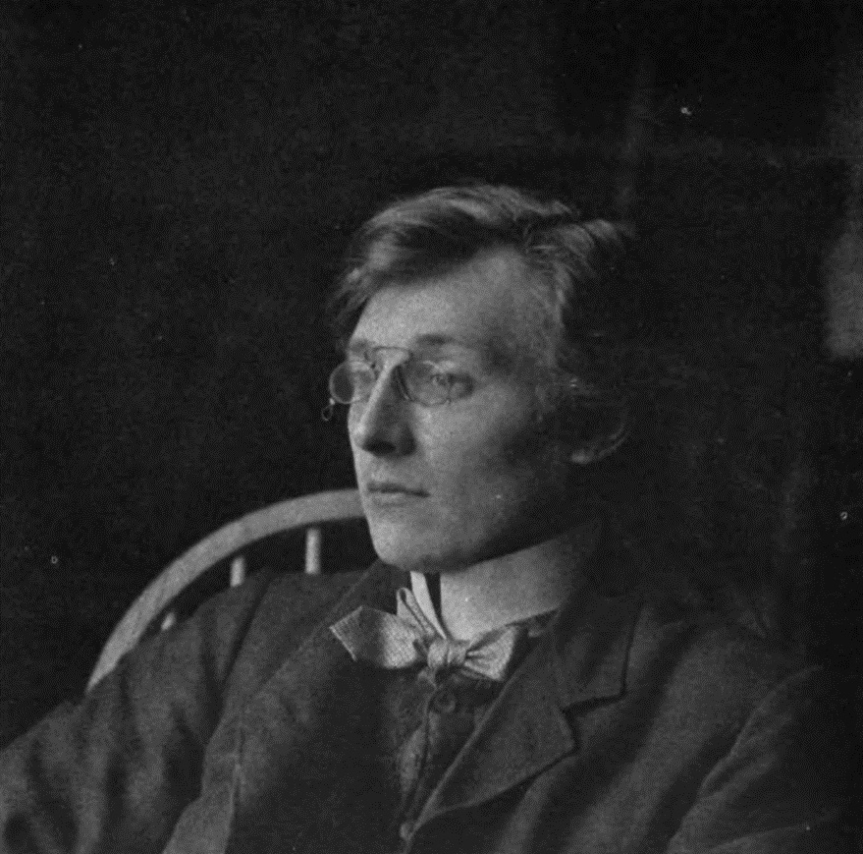
Edward Gordon Craig
Designer for the Purcell Operatic Society and for W.B. Yeats’s Abbey Theatre, late 19th century and early twentieth.
Stopped all theatre work at age of 40, and died in France in his nineties.

Slide 22
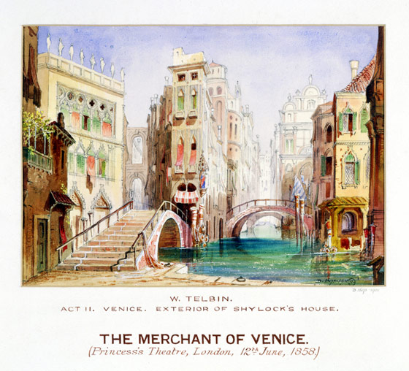
Princess Theatre, 1858
Scene for Shakespeare’s ‘Merchant of Venice’ by W. Telbin

Slide 23
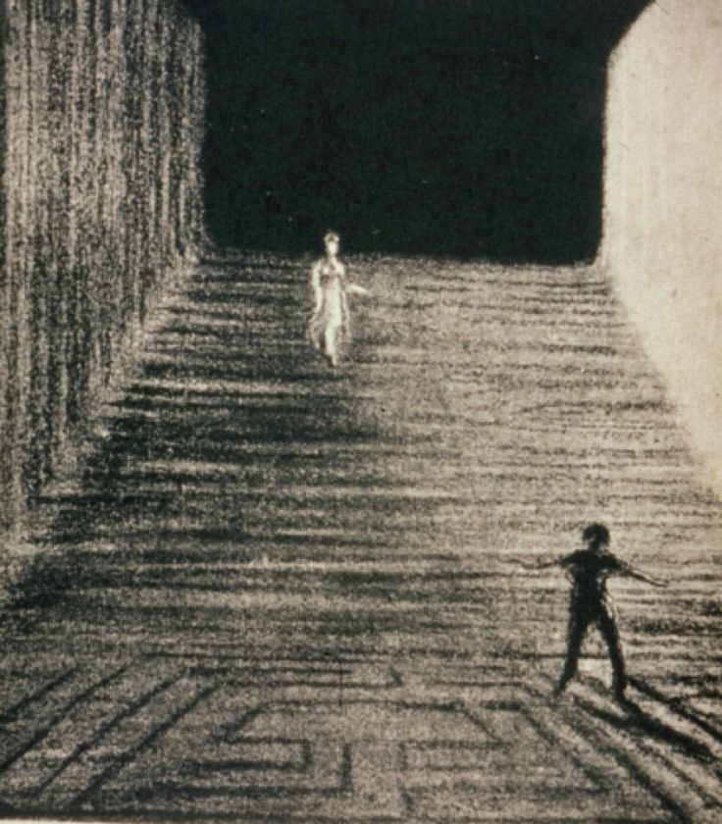
Sketch for scene by Edward Craig
Steps

Slide 24
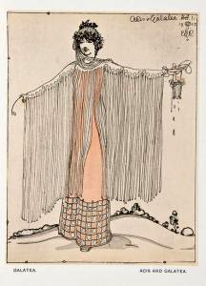
Costume design by Gordon Craig for Acis and Galatea

Slide 25
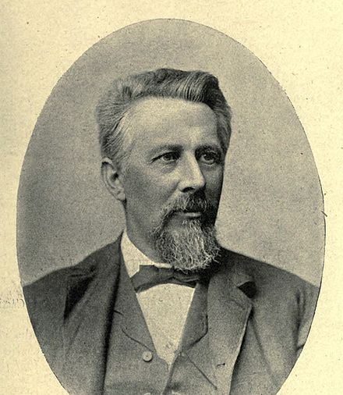
Edward Dowden 1843-1913
Professor of English, Trinity College Dublin

Slide 26
There was no possibility of my getting to London for the opening of the Lyceum, & so taking advantage of the kindness of the lessee & the Acting Manager. But I have seen in the London
papers how entire a success it was.
You will be pleased to hear that all your friends are engaged in writing dramas which through your influence are to be acted immediately at the Lyceum. I am myself at work on three tragedies, two melodramas, & a farce. It will I am sure be a pleasure to you to read these, you will see their merit, & I need not say any more.
[January 3, 1879]

Slide 27
My dear Stoker,
I could at once have thanked you for the very real pleasure I had in getting a gift from you, but I wanted also to thank you not for a gift but for the particular good thing I
had got. My wife & I are of one mind in thinking The Man a delightful novel, much out of the common in both characters & plain vivid in its rendering of character & full of the wisdom of life. It is pleasant to think that the book is that of an old friend. I wish it - though I don’t imagine that it needs the wish - all success with the public.
Always very sincerely yours
Edward Dowden [Sept 30, 1905 ]

Slide 28
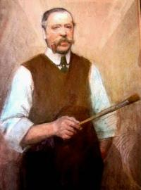
Joseph Harker 1855-1927
Portrait of Joseph Harker
Harker was an occasional scene-painter for the Lyceum. In his memoir are two chapters devoted to excoriating the new Decadent and Modernist trends in scene-painting as being a fad.

