Slide 1
Bubbles and Solow Growth Model - I
Oct/2023

Slide 2
What is economic growth (經濟增長) ?
Economic growth generally implies that income per person rises over time.
It is a “young” field of research.

Slide 3
If we search for “economic growth” in all the books published which have been scanned by Google (about 10% of all books):

Slide 4
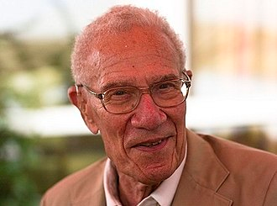
Solow model
Who is Solow and why his model (the Solow model) is so famous ?
Professor Robert Solow is an American economist known for his contribution to theory of economic growth.
How old is he ? He was born in .
Now, he is years old. He got Nobel
Prize 1987.
1924
99

Slide 5
In Solow model, physical capital (K) is very important.
K is one of the factors of production. (e.g. labor force, land, coal…)
K is a private good (私人物品)
Where does K come from ? Saving.

Slide 6
Solow, Robert M (1956). "A Contribution to the Theory of Economic
Growth". Quarterly Journal of Economics (The MIT Press) 70 (1): 65–
94
Google scholar citation: 41531

Slide 7
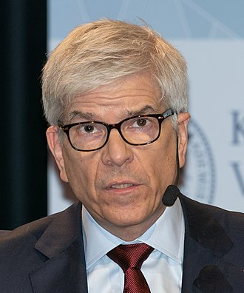
Prof. Paul Romer (1955 - )
The founder of Research and
Development growth model where
monopoly firms are at the core of
modern growth. He got Nobel Prize
in 2018.

Slide 8
In R & D growth model, knowledge (or technology, A) is very important.
A is a factor of production.
Note: knowledge (A) is a public good (公共物品).

Slide 9
Add one computer ⇒ make one worker more productive.
Ideas: Add one new idea ⇒ make everyone better off / productive.
Example: a new / an easier method to solve partial differential equations.

Slide 10
Where does A come from ? It comes from people.
When more and more people do R & D, more likely for us to have new ideas and new knowledge.

Slide 11
"Increasing Returns and Long Run Growth" (Journal of Political Economy, October 1986).
Google scholar citation: 35734
"Endogenous Technological Change" (Journal of Political Economy, October 1990).
Google scholar citation: 39467

Slide 12
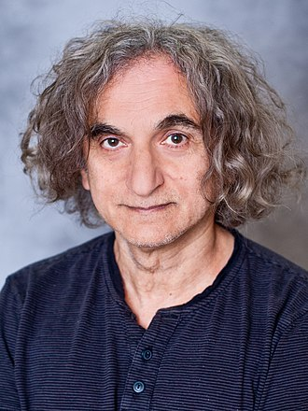
- Prof. Oded Galor (1953 - )
He is an Economic Historian.
He proposes an unified growth
theory (統一經濟理論), with the
purpose to explain the evolution
of the hman history.

Slide 13
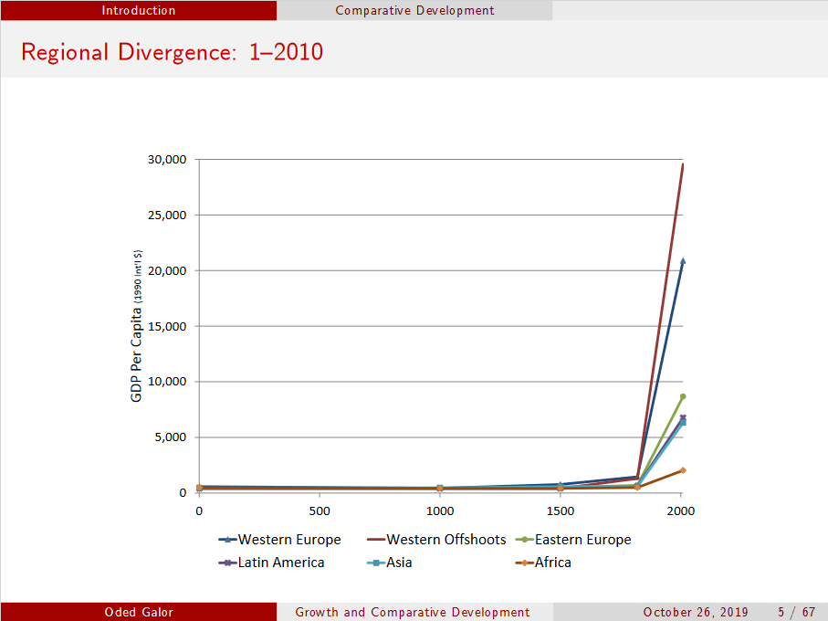
工業革命

Slide 14



Slide 15
“Income distribution and Macroeconomics” (Review of Economic Studies, January 1993)
Google scholar citation: 6772
“Population, technology, and growth: From Malthusian stagnation to the demographic transition and beyond” (American Economic Review, September 2000)
Google scholar citation: 3115

Slide 16

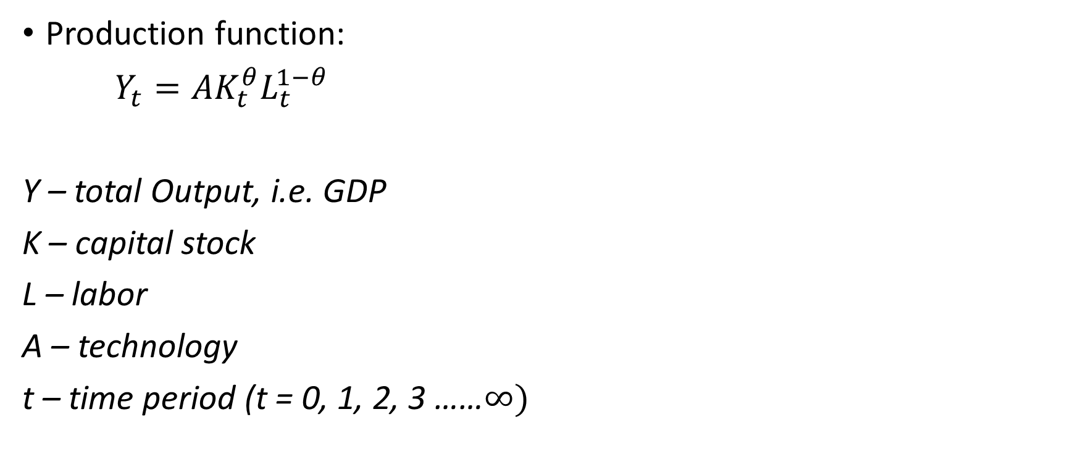
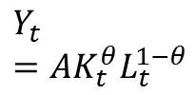


A basic Solow model
$$K_{t}$$
Production function:
$Y_{t}={AK}_{t}^{θ}L_{t}^{1−θ}$
Y – total Output, i.e. GDP
K – capital stock
L – labor
A – technology
t – time period (t = 0, 1, 2, 3 ……$∞)$
A
$$Y_{t}=AK_{t}^{θ}L_{t}^{1−θ}$$
$$Y_{t}$$
$$L_{t}$$

Slide 17
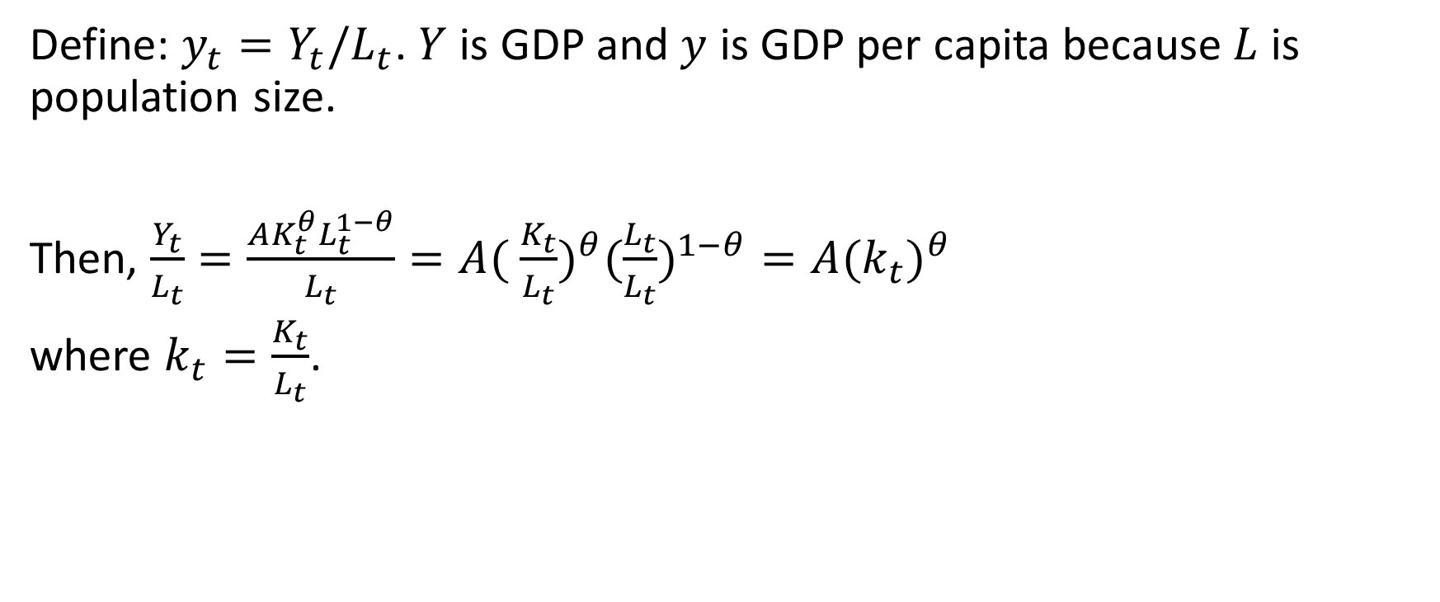
Define: $y_{t}=Y_{t}/L_{t}$. $Y$ is GDP and $y$ is GDP per capita because $L$ is population size.
Then, $\frac{Y_{t}}{L_{t}}=\frac{AK_{t}^{θ}L_{t}^{1−θ}}{L_{t}}=A( {\frac{K_{t}}{L_{t}})}^{θ}(\frac{L_{t}}{L_{t}})^{1−θ}=A(k_{t})^{θ}$
where $k_{t}=\frac{K_{t}}{L_{t}}$.

Slide 18
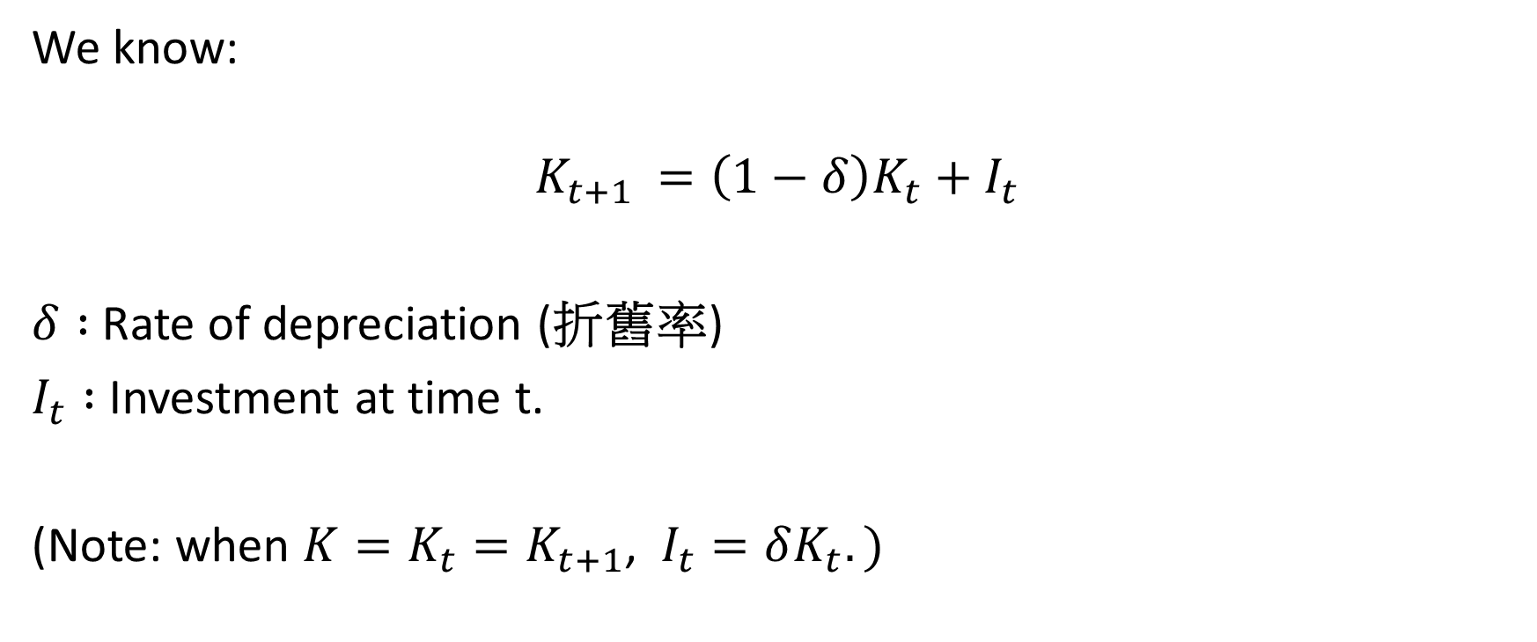
We know:
$$K_{t+1 }=\left(1−δ\right)K_{t}+I_{t}$$
$δ :$Rate of depreciation (折舊率)
$I_{t} :$Investment at time t.
(Note: when $K=K_{t}=K_{t+1}$, $I_{t}=δK_{t}.)$

Slide 19
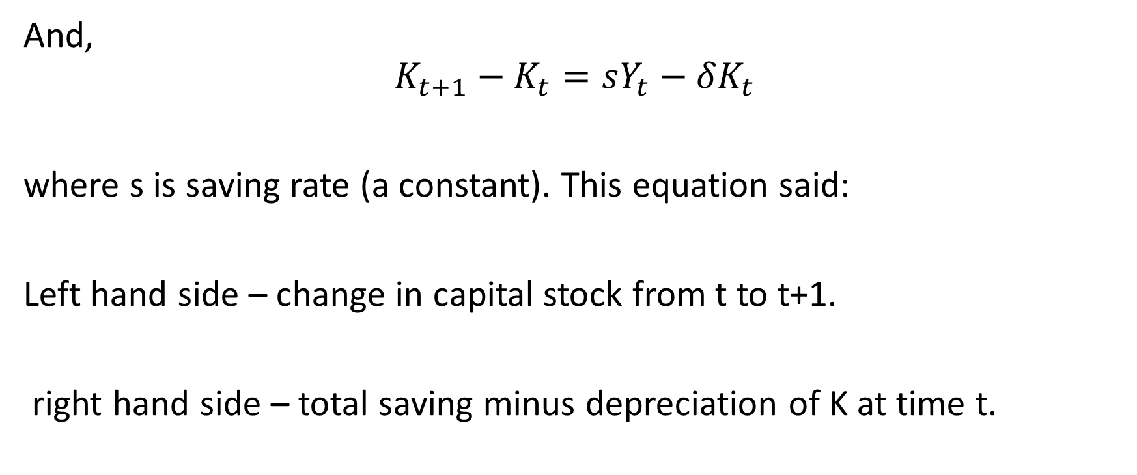
And,
$$K_{t+1}−K_{t}=sY_{t}−δK_{t}$$
where s is saving rate (a constant). This equation said:
Left hand side – change in capital stock from t to t+1.
right hand side – total saving minus depreciation of K at time t.

Slide 20

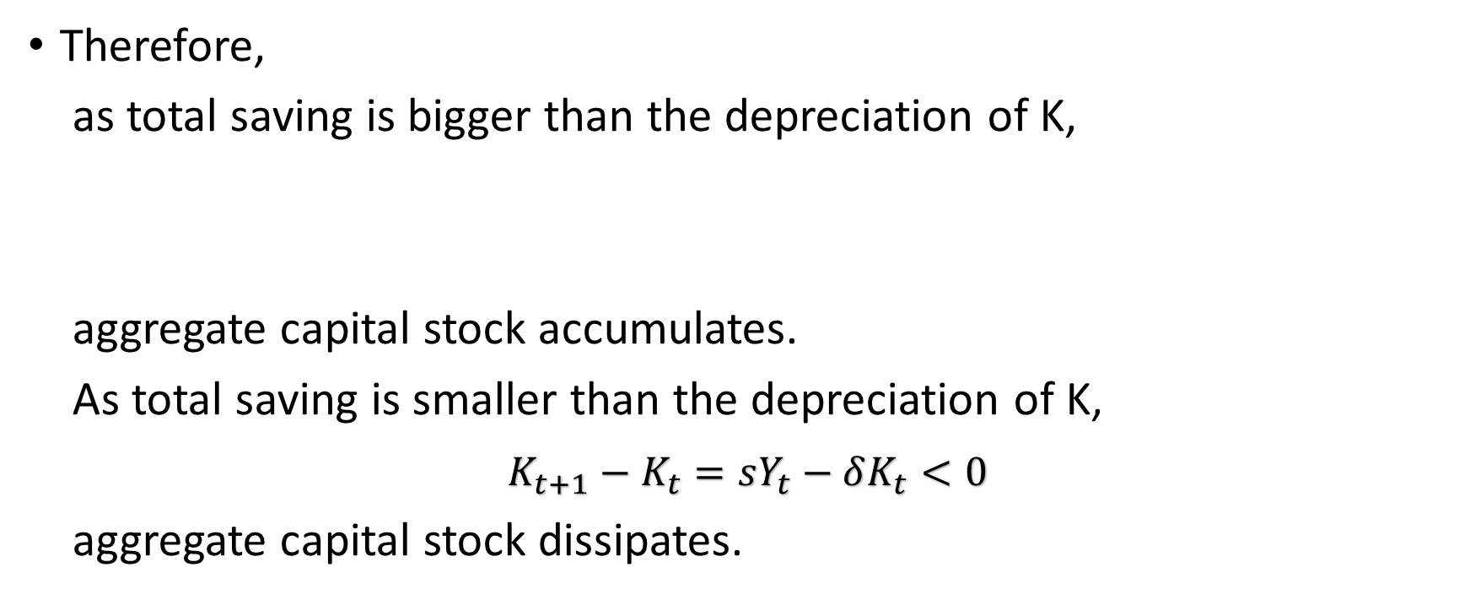
Therefore,
as total saving is bigger than the depreciation of K,
aggregate capital stock accumulates.
As total saving is smaller than the depreciation of K,
$K_{t+1}−K_{t}=sY_{t}−δK_{t}<0$
aggregate capital stock dissipates.
$$K_{t+1}−K_{t}=sY_{t}−δK_{t}>0$$

Slide 21
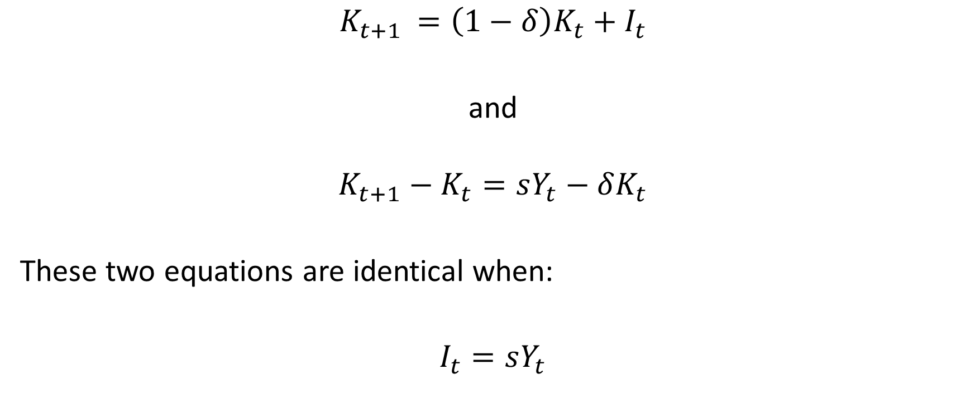
$$K_{t+1 }=\left(1−δ\right)K_{t}+I_{t}$$
and
$$K_{t+1}−K_{t}=sY_{t}−δK_{t}$$
These two equations are identical when:
$I_{t}=sY_{t}$

Slide 22
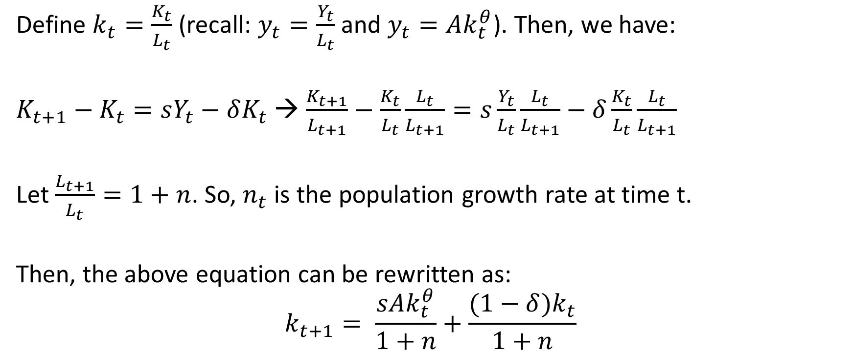
Define $k_{t}=\frac{K_{t}}{L_{t}}$ (recall: $y_{t}=\frac{Y_{t}}{L_{t}}$ and $y_{t}=Ak_{t}^{θ}$). Then, we have:
$K_{t+1}−K_{t}=sY_{t}−δK_{t}$ → $\frac{K_{t+1}}{L_{t+1}}−\frac{K_{t}}{L_{t}}\frac{L_{t}}{L_{t+1}}=s\frac{Y_{t}}{L_{t}}\frac{L_{t}}{L_{t+1}}−δ\frac{K_{t}}{L_{t}}\frac{L_{t}}{L_{t+1}}$
Let $\frac{L_{t+1}}{L_{t}}=1+n$. So, $n_{t}$ is the population growth rate at time t.
Then, the above equation can be rewritten as:
$$k_{t+1}= \frac{sAk_{t}^{θ}}{1+n}+\frac{(1−δ)k_{t}}{1+n}$$

Slide 23
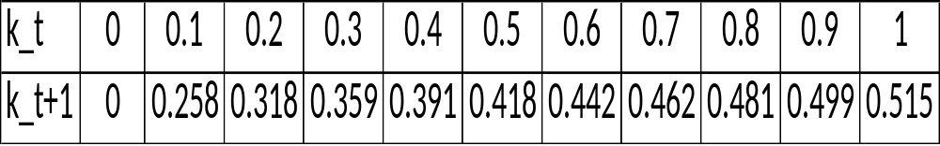
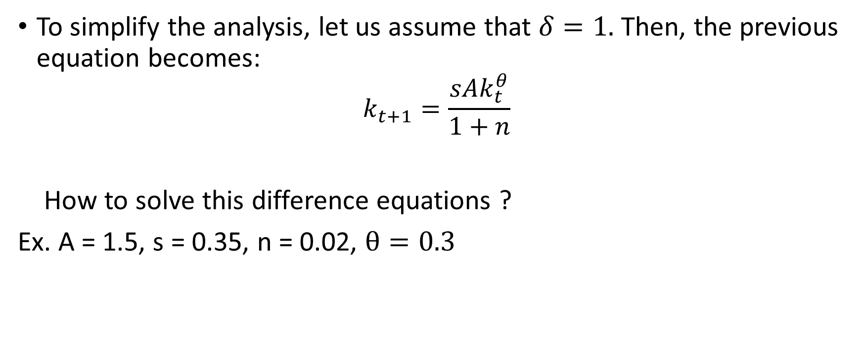

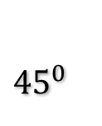
To simplify the analysis, let us assume that $δ=1.$ Then, the previous equation becomes:
$$k_{t+1}=\frac{sAk_{t}^{θ}}{1+n}$$
How to solve this difference equations ?
Ex. A = 1.5, s = 0.35, n = 0.02, $θ=0.3$
k_t+1
${45}^{0}$
E
k_t
$$k^{∗}=0.39$$

Slide 24
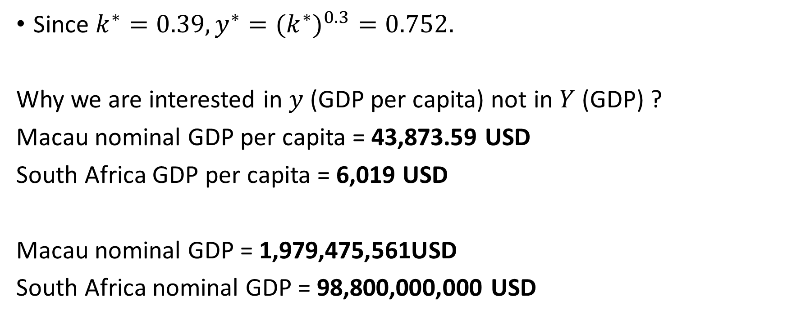
Since $k^{∗}=0.39, y^{∗}=(k^{∗})^{0.3}=0.752.$
Why we are interested in $y$ (GDP per capita) not in $Y$ (GDP) ?
Macau nominal GDP per capita = 43,873.59 USD
South Africa GDP per capita = 6,019 USD
Macau nominal GDP = 1,979,475,561USD
South Africa nominal GDP = 98,800,000,000 USD

Slide 25




$$E$$
45⁰
$$k_{t+1}$$
$$k_{t}$$
k₀
$$k^{∗}$$
The steady state E is stable !

Slide 26
Now, suppose that s decreases,
a country’s k (and, of course, y)
will go down !
k_t+1
E
E’
k_t
k*

Slide 27

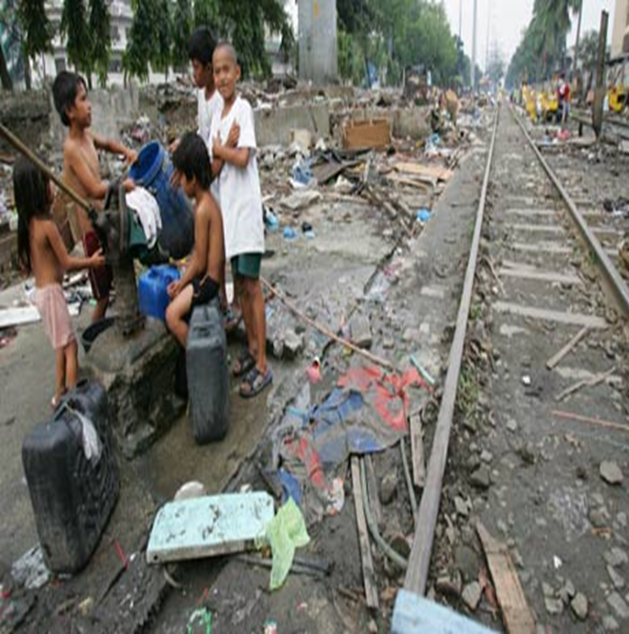
The above results can be used to explain why some countries are rich and some are poor !

Slide 28
Countries which save more (less) tend to be rich (poor).
Countries which have high (low) population growth tend to be poor (rich).

